Slide 1

SUNIL ENGINEERING WORKS
SHEETAL IND. NO. 6, GALA NO. 12, NAVGHAR, VASAI (E),

Slide 2
Factory details
1] 30 ton power press
2] 50 ton power press
3] 10 ton power press (3 nos )
4] 3 ton power press (2 nos )
5] 5 ton power press
6] 2 surface grander machine
7] 2 Drill machine
8] SPM bending machine ( 6 nos )
9] 2 no. hand press ( 3 nos )
3 no. hand press (1 nos)
10] compressor
5 HP (1 nos )
3 HP (1 nos )

Slide 3
MANPOWER
3 PRESS OPERATOR
5 LADIES WORKERS
4 GENTS WORKERS

Slide 4
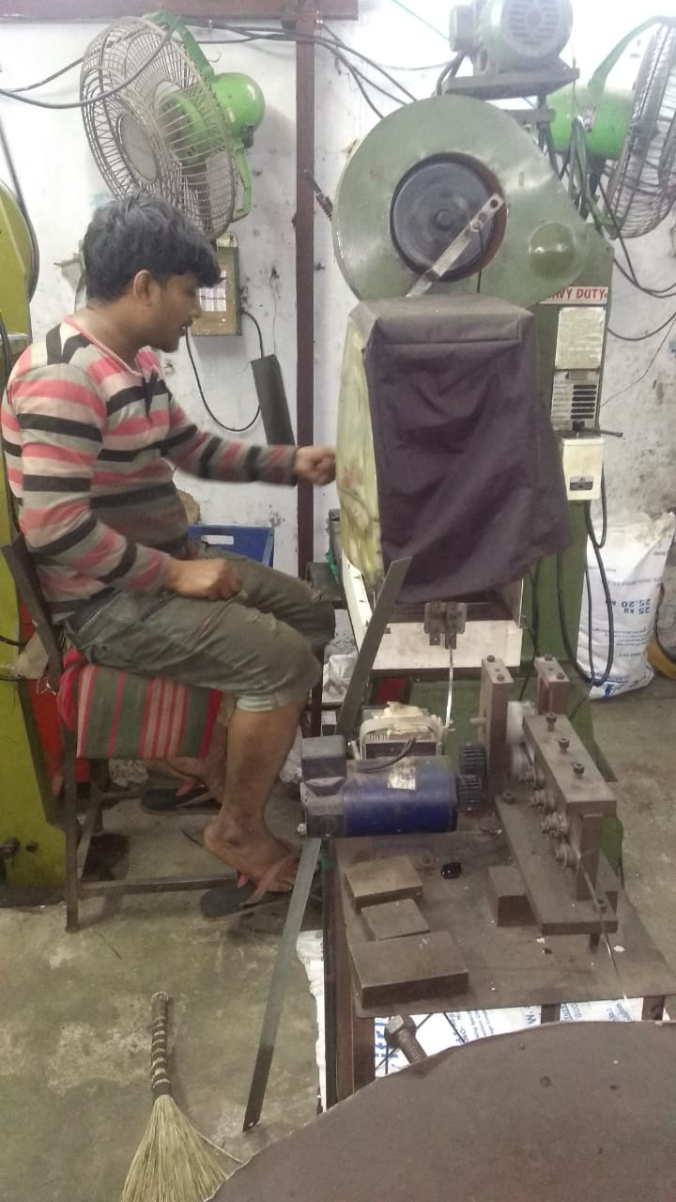
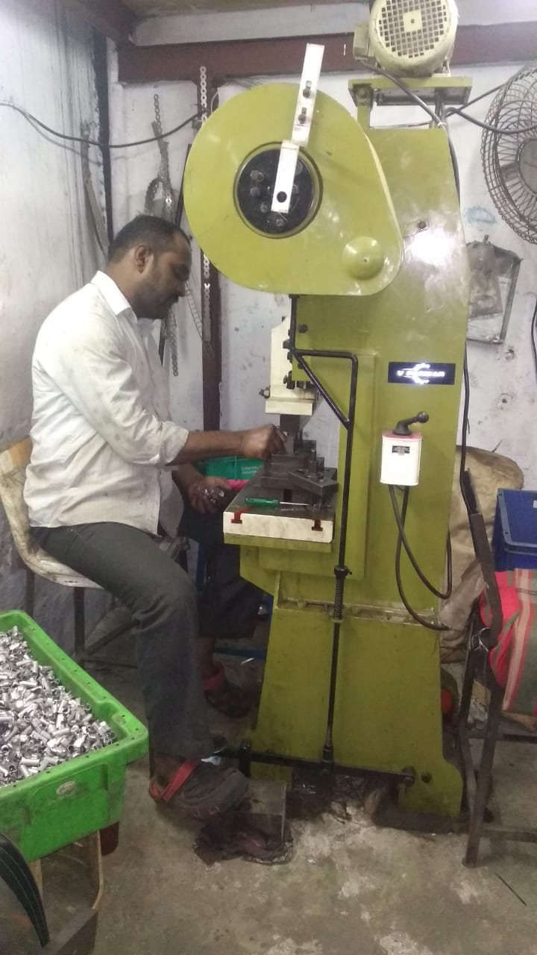
PRESS OPERATOR 10 TON PRESS

Slide 5
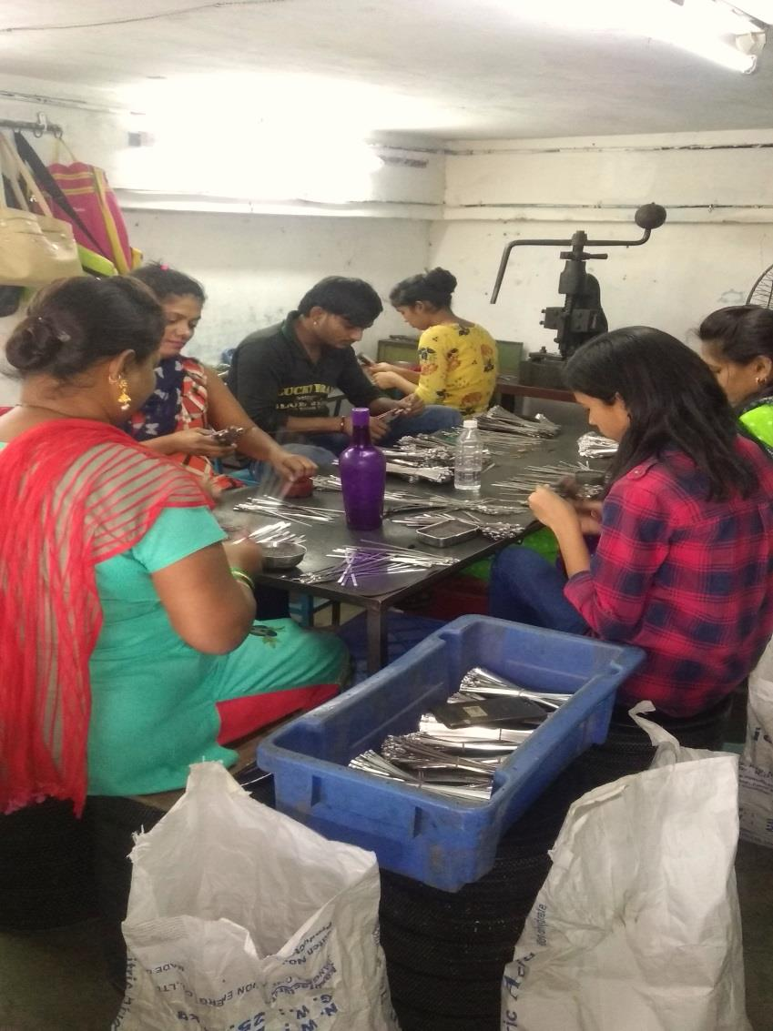
STAFF WORKERS

Slide 6
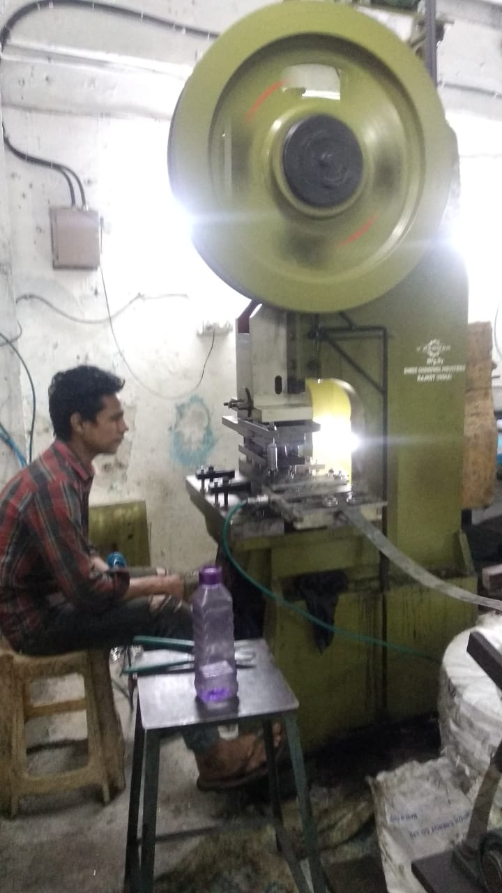
30 TON PRESS

Slide 7
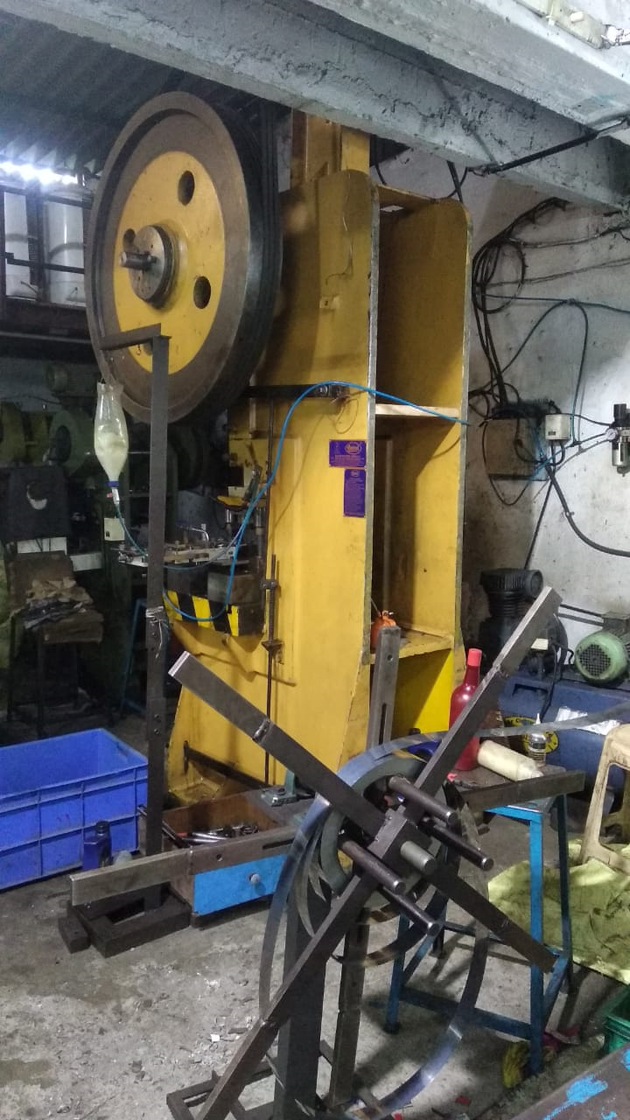
50 TON PRESS

Slide 8
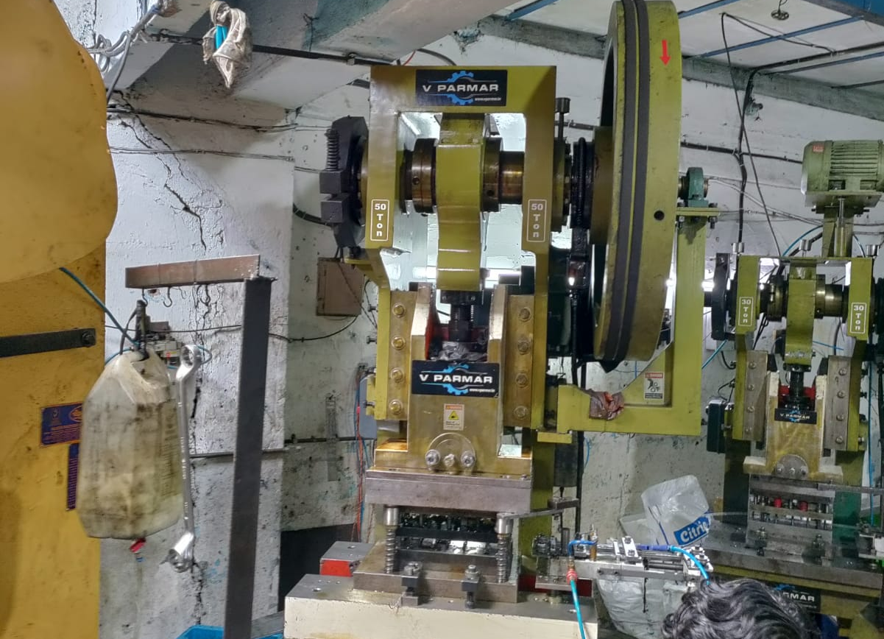
50 TON PRESS

Slide 9
PRODUCTS

Slide 10
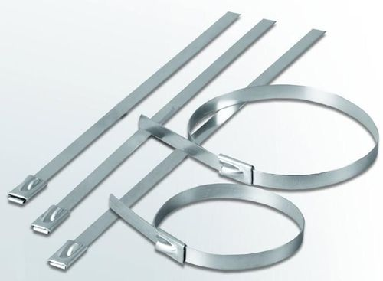
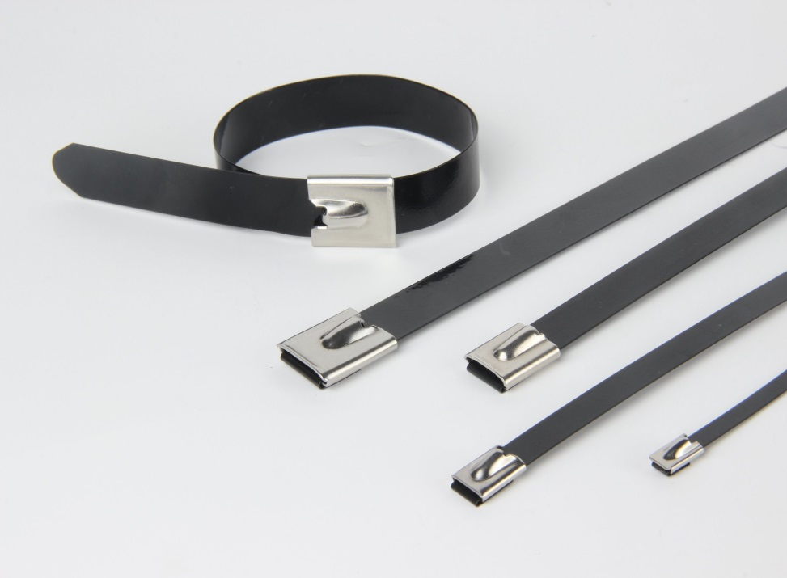
SS CABLE TIE
UNCOATED
COATED

Slide 11
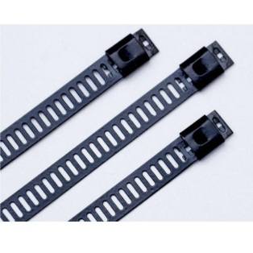
SS LADER

Slide 12
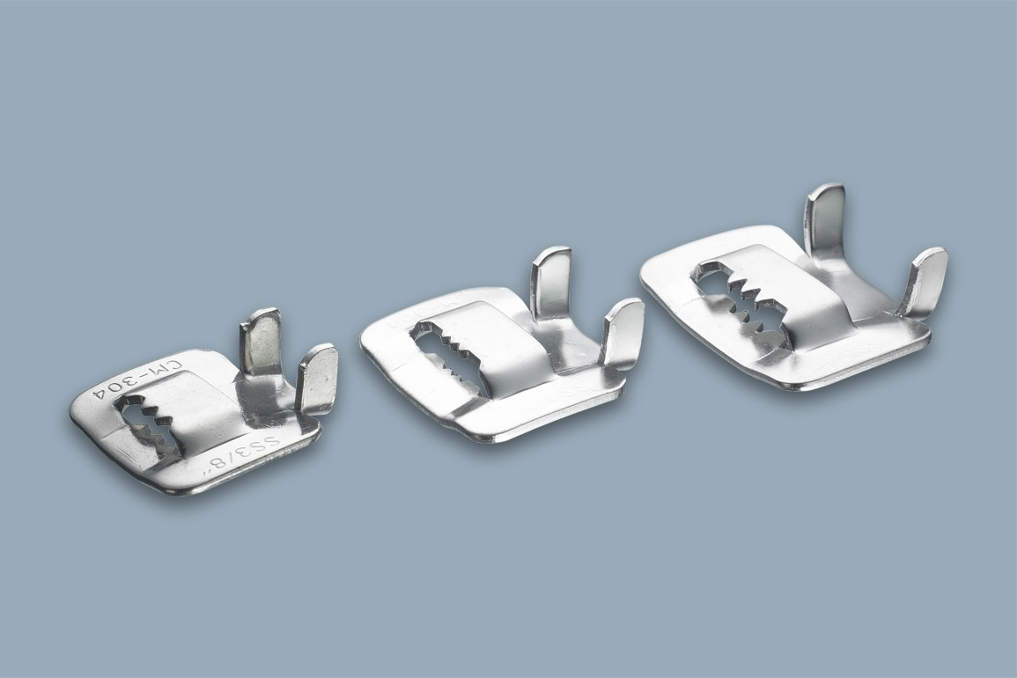
SS BUCKLE

Slide 13
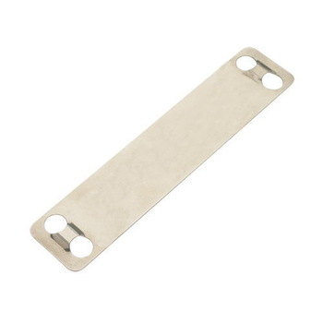
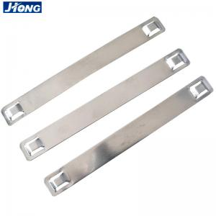
SS MARKER TAG

Slide 14
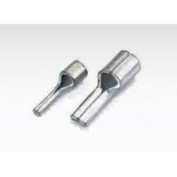
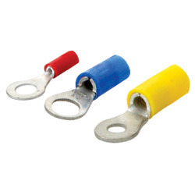
COPPER LUG

Slide 15
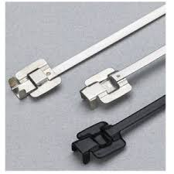
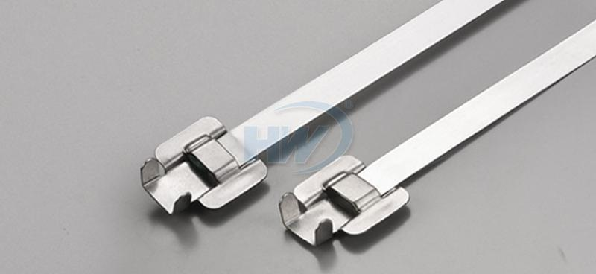
SS RELEASABLE TEI

Slide 16
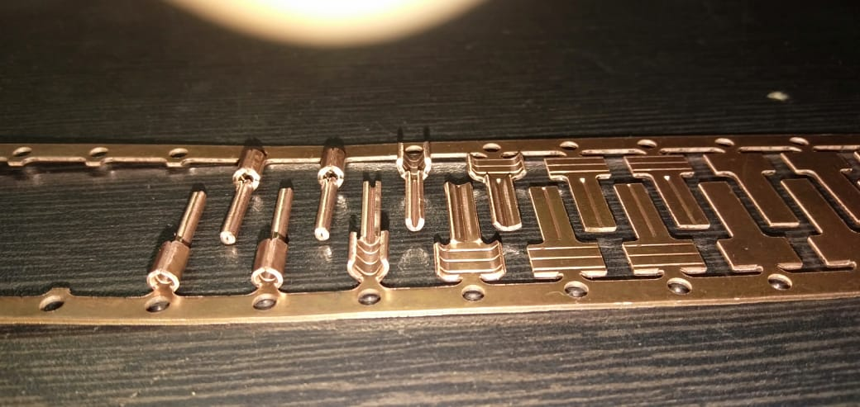

Slide 17
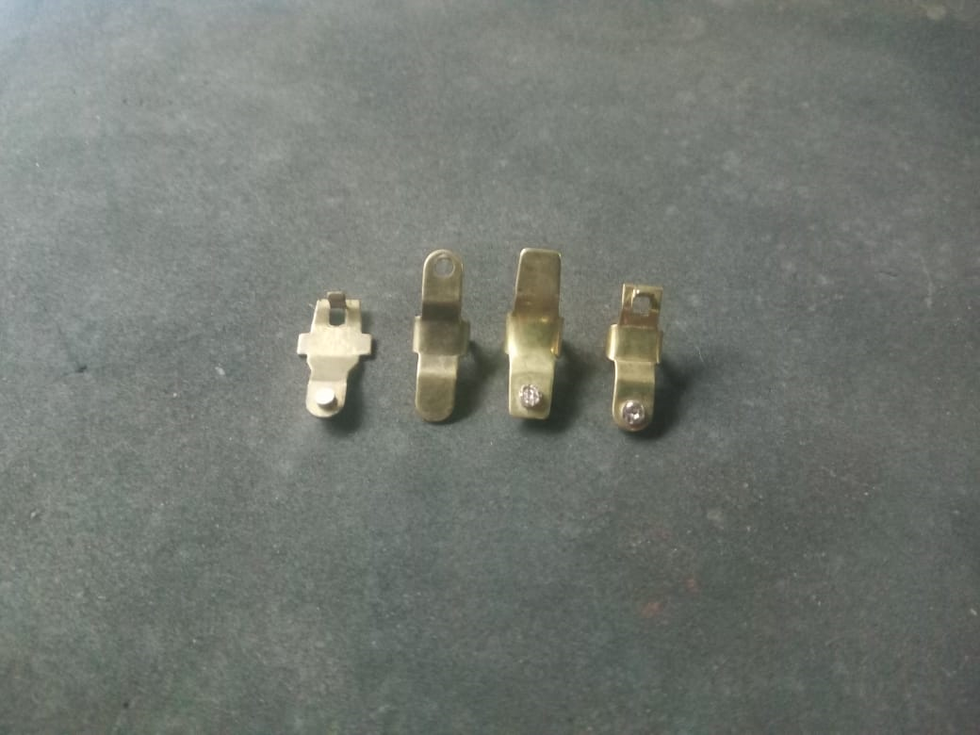
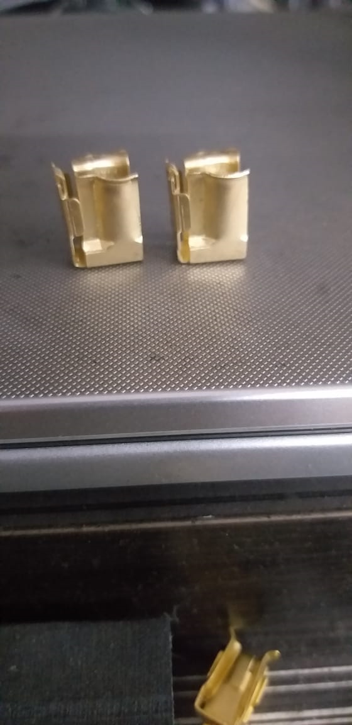

Slide 18
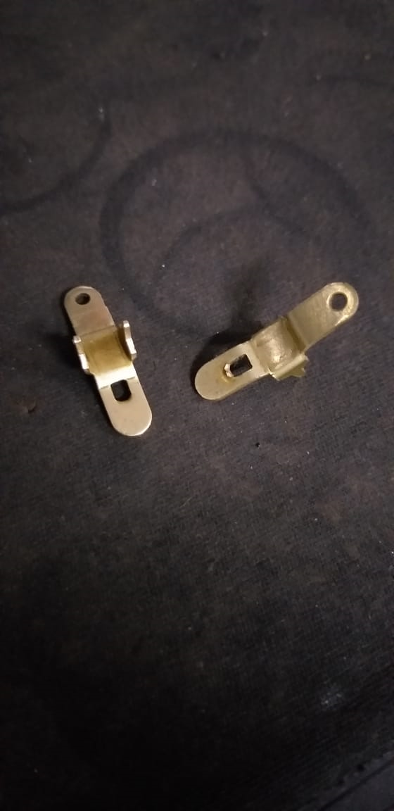
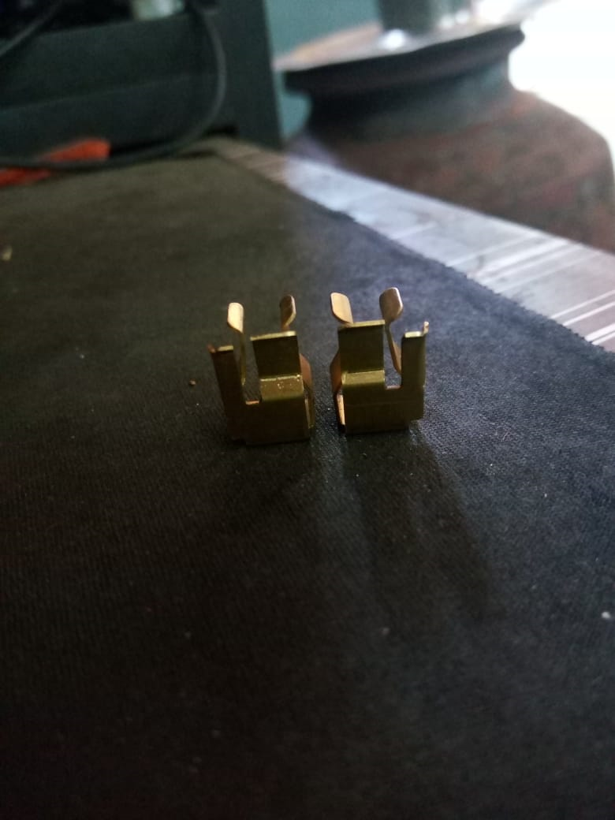

Slide 19
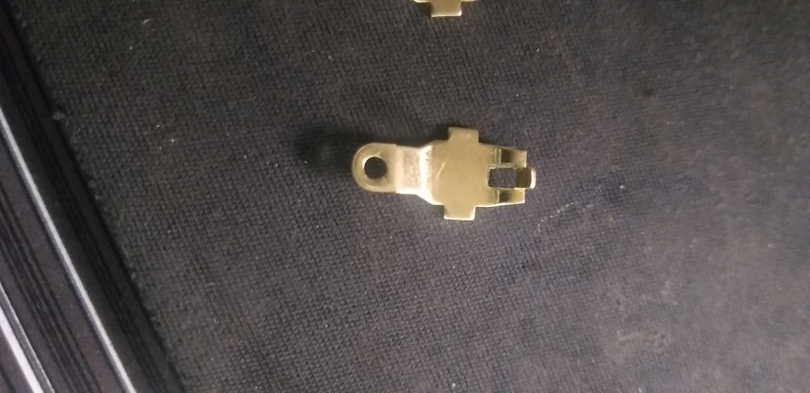
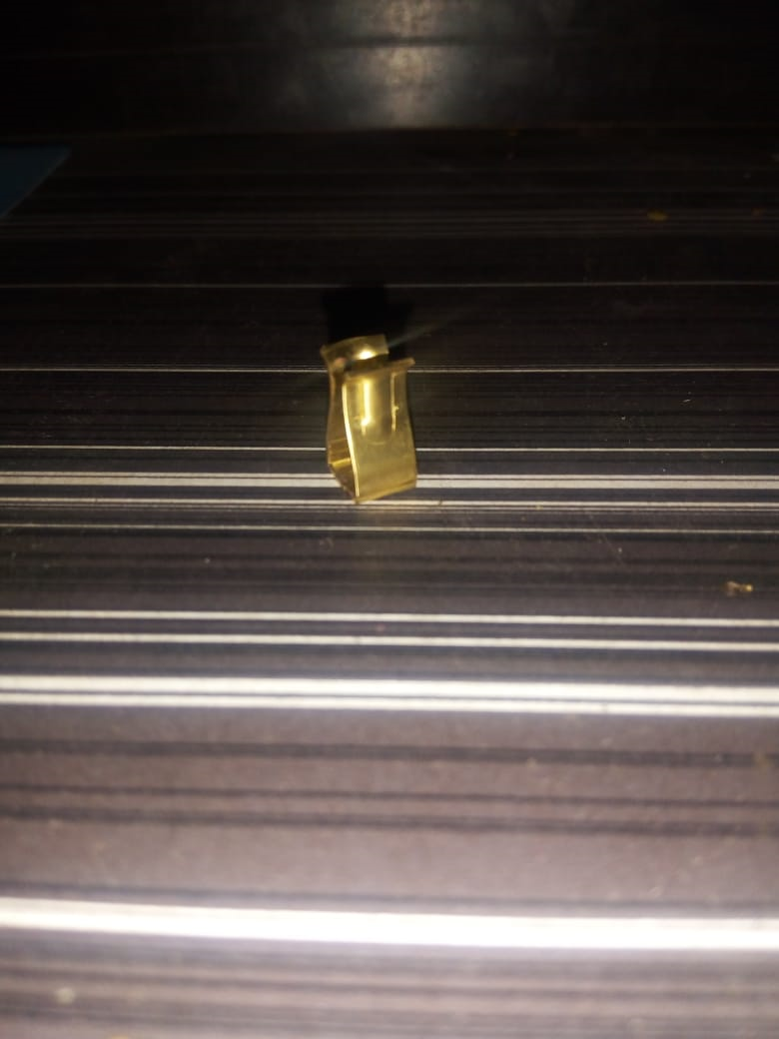

Slide 20
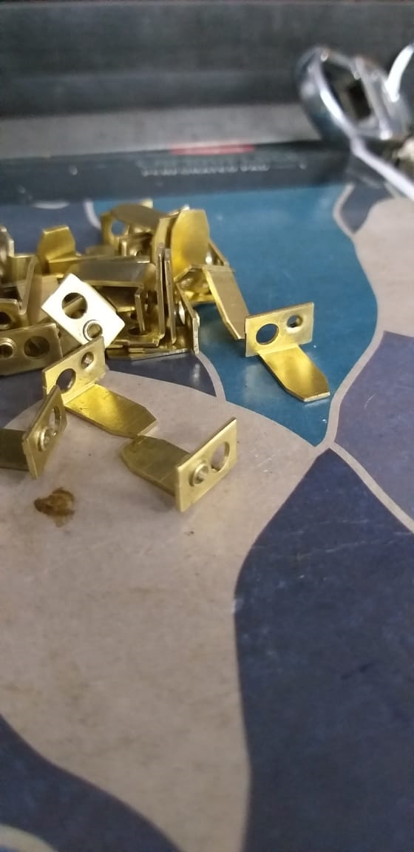
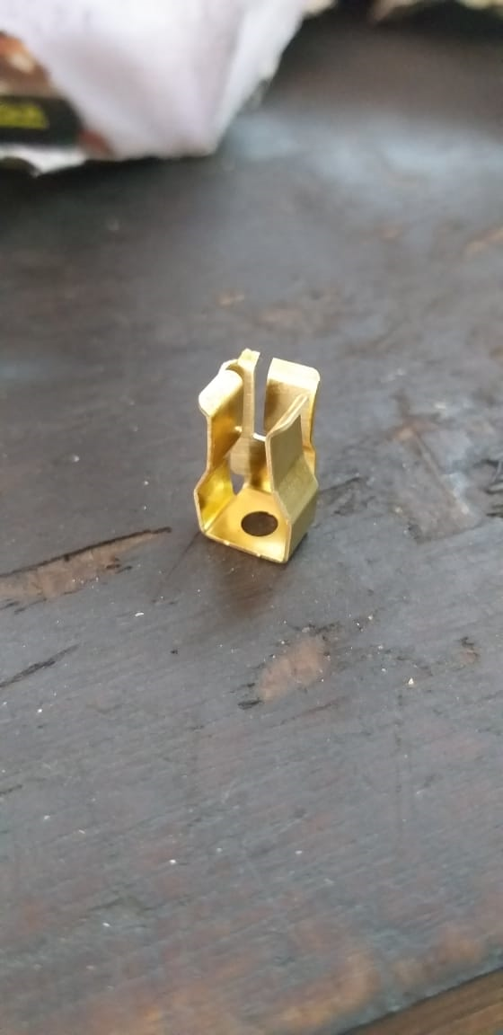

Slide 21
THANK YOU

